Slide 1
COFFEE ANALYSIS Time Frame – Latest 52 weeks by Kiran.K

Slide 2
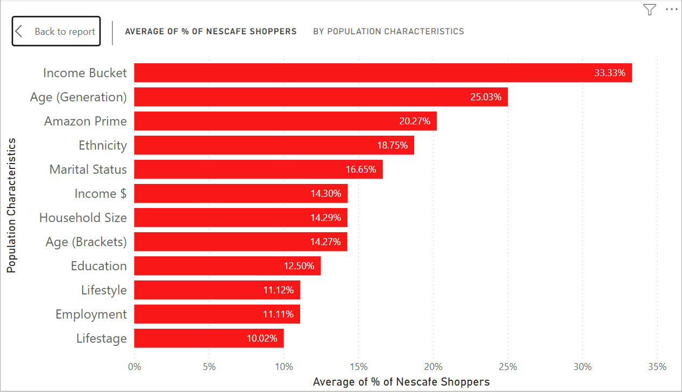
Who are the Nescafe Buyers and what are their characteristics ?
﻿At 33.33%, Income Bucket had the highest Average of % of Nescafe Shoppers and was 232.67% higher than Lifestage, which had the lowest Average of % of Nescafe Shoppers at 10.02%.
﻿Across all 12 Population Characteristics, Average of % of Nescafe Shoppers ranged from 10.02% to 33.33%.

Slide 3
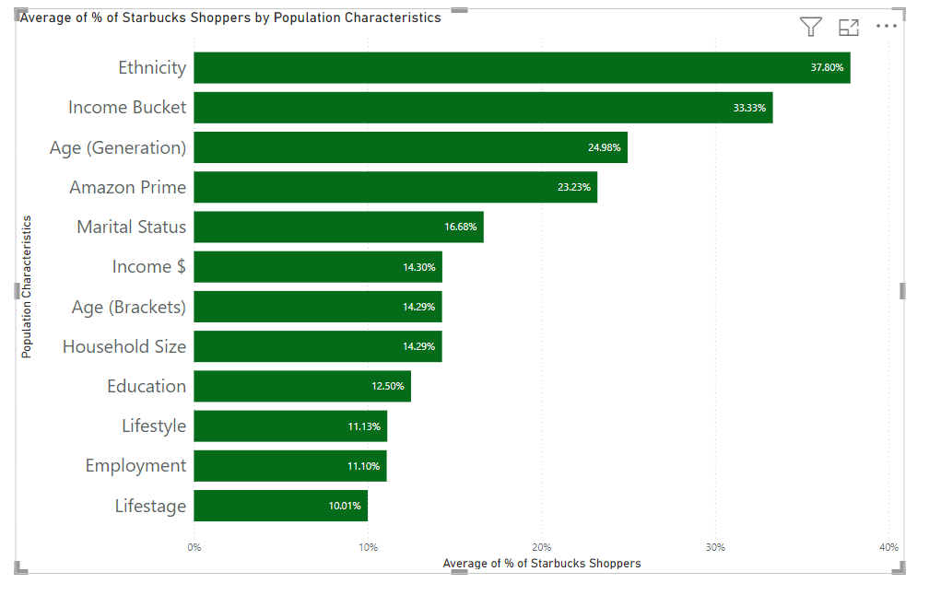
Who are the Starbucks Buyers and what are their characteristics ?
﻿At 37.80%, Ethnicity had the highest Average of % of Starbucks Shoppers and was 277.62% higher than Lifestage, which had the lowest Average of % of Starbucks Shoppers at 10.01%.
﻿Ethnicity had the highest Average of % of Starbucks Shoppers at 37.80%, followed by Income Bucket and Age (Generation). Lifestage had the lowest Average of % of Starbucks Shoppers at 10.01%.
﻿Across all 12 Population Characteristics, Average of % of Starbucks Shoppers ranged from 10.01% to 37.80%.

Slide 4
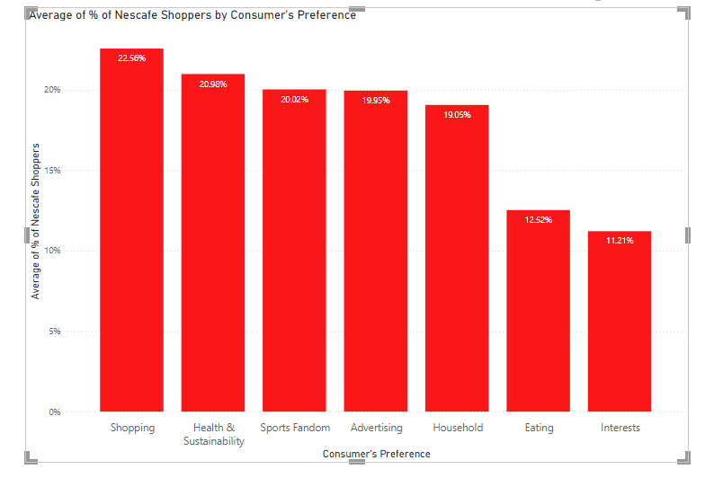
What are the Nescafe shoppers preference ?
﻿At 22.56%, Shopping had the highest Average of % of Nescafe Shoppers and was 101.22% higher than Interests, which had the lowest Average of % of Nescafe Shoppers at 11.21%.
﻿ ﻿﻿Across all 7 Consumer's Preference, Average of % of Nescafe Shoppers ranged from 11.21% to 22.56%.﻿﻿ ﻿

Slide 5
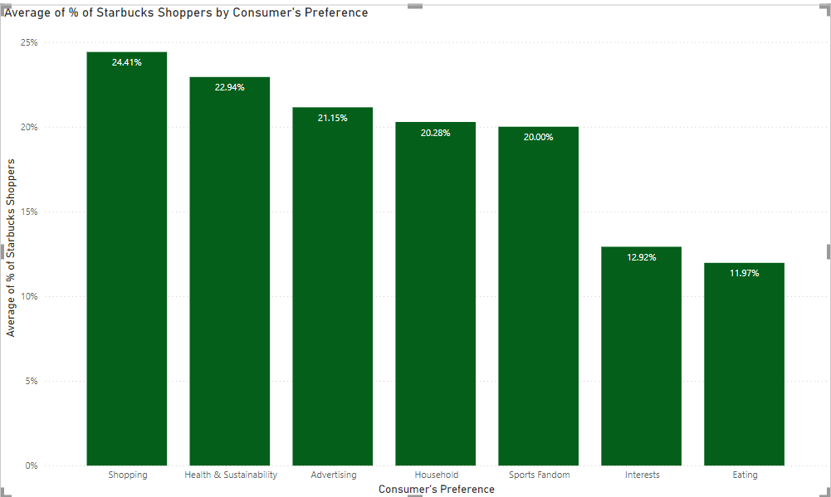
What are the Starbucks shoppers preference?
﻿At 24.41%, Shopping had the highest Average of % of Starbucks Shoppers and was 104.00% higher than Eating, which had the lowest Average of % of Starbucks Shoppers at 11.97%.
﻿Across all 7 Consumer's Preference, Average of % of Starbucks Shoppers ranged from 11.97% to 24.41%.

Slide 6
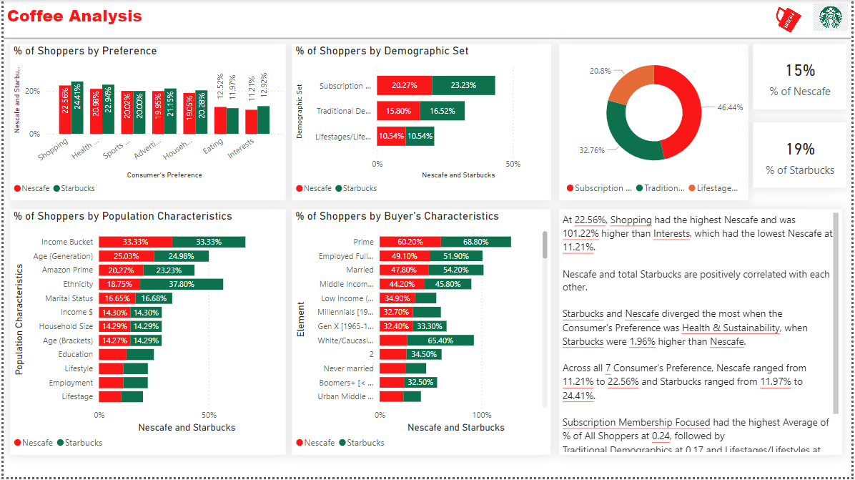

Slide 7
How do Nescafe shoppers differ from Starbucks shoppers? How Nescafe can attract/capture Starbucks shoppers?
Demographics: Nescafé shoppers might lean towards being more cost-conscious, often seeking value for money. They could be more likely to consume coffee at home or work, preferring convenience. On the other hand, Starbucks shoppers may skew towards a more premium-seeking demographic, willing to pay extra for the café experience, personalized coffee, and the brand’s association with lifestyle and status.
Behavioral Factors: Nescafé consumers may prioritize convenience and affordability, purchasing coffee in bulk for daily consumption. In contrast, Starbucks shoppers might value the social and experiential aspects of coffee consumption, enjoying the atmosphere of Starbucks outlets, or the customized coffee options.
Nescafe can attract more customers by strategically positioning Nescafé as both a convenient and high-quality alternative to Starbucks, while simultaneously offering competitive pricing and innovative products, the brand can effectively attract and capture a segment of Starbucks’ consumer base.

